Slide 1
Cost Concepts

Slide 2
Objective of the lecture
To analyse short-term alternatives when time value of money is not a factor.

Slide 3
Cost can be categorized in several ways (1)
Fixed cost: unaffected by changes in activity level
Variable cost: vary in total with the quantity of output (or similar measure of activity)
Incremental cost: additional cost resulting from increasing output of a system by one (or more) units

Slide 4
Cost can be categorized in several ways (2)
Direct: can be measured and allocated to a specific work activity
Indirect: difficult to attribute or allocate to a specific output or work activity (also overhead or burden)
Standard cost: cost per unit of output, established in advance of production or service delivery

Slide 5
cost terminology (1)
Cash cost: a cost that involves a payment of cash.
Book cost: a cost that does not involve a cash transaction but is reflected in the accounting system.
Sunk cost: a cost that has occurred in the past and has no relevance to estimates of future costs and revenues related to an alternative course of action.

Slide 6
cost terminology (2)
Opportunity cost: the monetary advantage foregone due to limited resources. The cost of the best rejected opportunity.
Life-cycle cost: the summation of all costs related to a product, structure, system, or service during its life span.

Slide 7
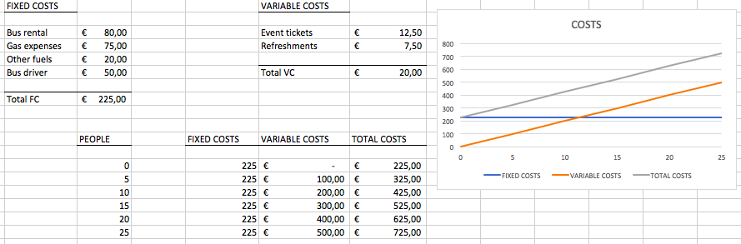
Example (TABLE and graph presented in Excel file)
Amin plans to charter a bus to take people to see some events show in the city. He categorized his costs at shown below:
Which of the costs are fixed and which are variable costs?
How do we compute Amin’s total cost if he takes n people to City?
Total Cost = Fixed cost + Variable cost

Slide 8
Average and Marginal Costs
Average Cost: Computed as total cost divided by the number of units produced.
Marginal Cost: The change in total cost that arises when the quantity produced changes by one unit; i.e. the cost to produce one more unit.
Avg. Cost = TC/n= (225+20n)/n
For n = 33, TC = 885
Avg. Cost = 885/30 = 29.50
Total cost cannot be calculated from an average cost value
For n =35: TC=35*(29.50) = 1,032.50

Slide 9
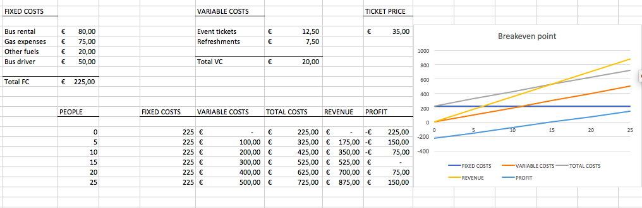
Example TABLE and graph presented in Excel file

Slide 10
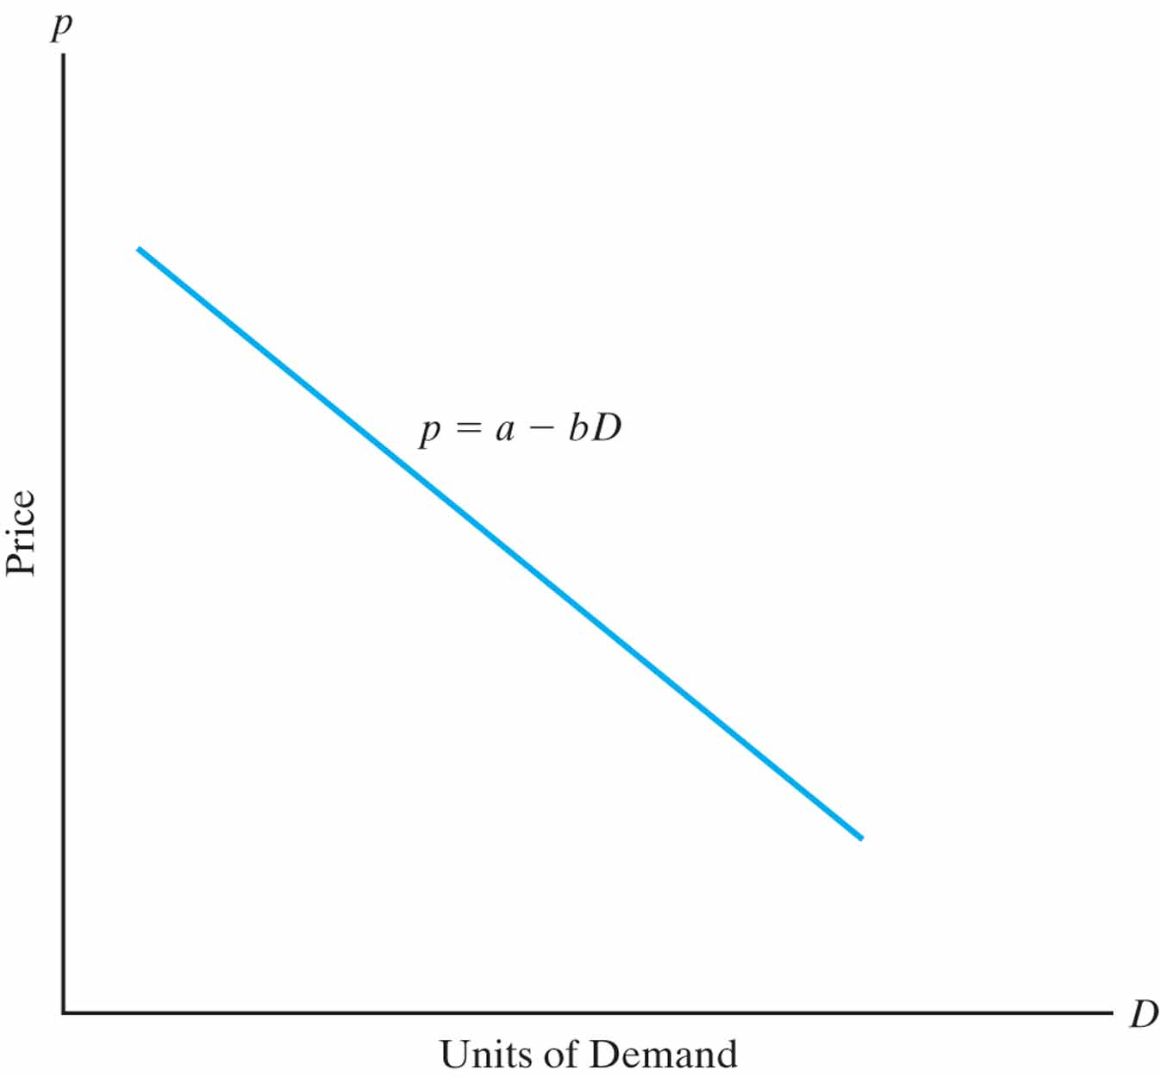
Profit and Loss Terms (non-linear cost and revenue)
Total revenue = Unit price x units sold
Breakeven: total revenue = total costs
Just getting by
Profit region:
total revenue > total costs
Putting money in the bank
Loss region:
total revenue < total costs
Going into debt

Slide 11
Sunk (Past) Costs
A sunk cost is money already spent due to a past decision.
As engineering economists we deal with present and future opportunities
We must be careful not to be influenced by the past
Disregard sunk costs in engineering economic analysis
Example: Suppose that three years ago you bought a laptop PC for € 2,000.
How likely is it that you can sell it today for what it cost?
Suppose you can sell the laptop today for €400. Does the €2000 purchase cost have any effect on the selling price today?
The €2,000 is a sunk cost. It has no influence on the present opportunity to sell the laptop for €400.

Slide 12
Opportunity (Future) Cost
An opportunity cost is a benefit that is foregone by engaging a business resource in a chosen activity instead of engaging that same resource in the foregone activity.
Example:
Suppose your wealthy uncle gives you € 75,000 when you graduate from high school. It is enough to put you through college (5 years at € 15,000 per year). It is also enough for you to open a business making web pages for small companies instead of going to college.
You estimate you would make € 20,000 per year with this business.
If you decide to go to college you give up the opportunity to make € 20,000 per year
Your opportunity cost is € 20,000
Your total cost per year is € 35,000

Slide 13
Recurring and Non-Recurring Costs
Recurring costs are those expenses that are known, anticipated, and occur at regular intervals.
These costs can be modeled as cash flows.
Non-recurring costs are one-of-a-kind (one-time) event that occurs at irregular intervals. They are difficult to plan for or anticipate.
Example:
A company decided to landscape a lot of ground and then care for it. Which are recurring and which are non-recurring costs the company incur?
Remove existing trees, vegetation
Have land graded with bulldozer
Have yard planted with grass
Plant shrubs, trees
Mow grass
Fertilize grass, shrubs
Water grass, shrubs

Slide 14
Incremental Cost
Incremental Cost is the additional cost that results from selecting one alternative over another.
It is the difference in cost between two alternative investments or activities.

Slide 15
Cash Costs vs. Book Costs
Cash Costs: require the cash transaction of euros out of one person’s pocket into the pocket of someone else.
Book Costs: cost of a past transaction that is recorded in a book (accounting book) of a firm
Do not represent cash flows
Not included in engineering economic analysis
One exception is for asset depreciation (used for tax purposes)
Example:
You got offers to sell your car for € 6,000 (i.e., the book value of your car is € 6,000). The book value can be thought of as the book cost. If you actually sell the car to a friend for € 5,500, then the cash cost to your friend is € 5,500.

Slide 16
Life-Cycle Costs
Life-cycle Costs are the summation of all costs, both recurring and nonrecurring, related to a product, structure, system, or service during its lifetime.
Products go through a life cycle in phases:
Assessment & Justification
Conceptual or Preliminary Design
Detailed Design
Production or Construction
Operational Use
Decline and Retirement
Engineers should consider all life-cycle costs when designing
products and the systems that produce them.
About 70-90% of all costs are set during the design phases when only 10-30% of cumulative life-cycle costs have been spent.

Slide 17
The general price-demand relationship
The demand for a product or service is directly related to its price according to p=a-bD
where p is price, D is demand, and a and b are constants that depend on the particular product or service.

Slide 18

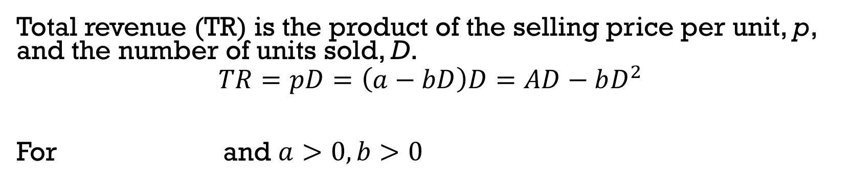
Total revenue depends on price and demand
Total revenue (TR) is the product of the selling price per unit, p, and the number of units sold, D.
$$TR=pD=\left(a−bD\right)D=AD−bD^{2}$$
For and $a>0, b>0$
$$0≤D≤\frac{a}{b}$$

Slide 19
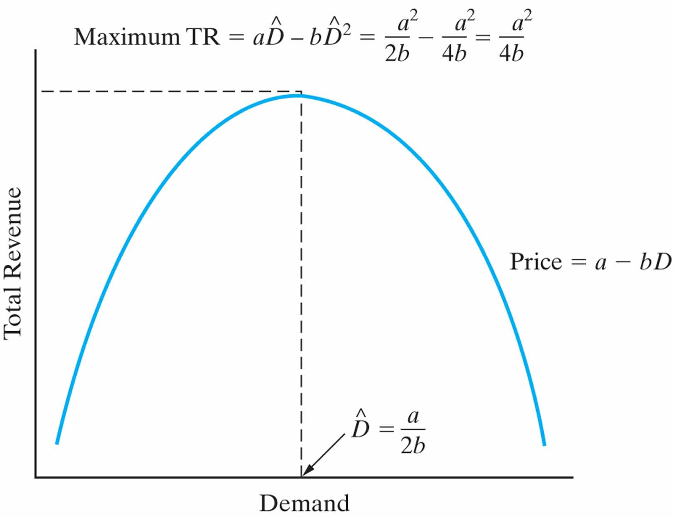

Calculus can help determine the demand that maximizes revenue
$\text{Solving} \text{the}$
$\frac{dTR}{dD}=a−2bD=0$
the optimal demand is
$\hat{D}=\frac{a}{2b}$

Slide 20
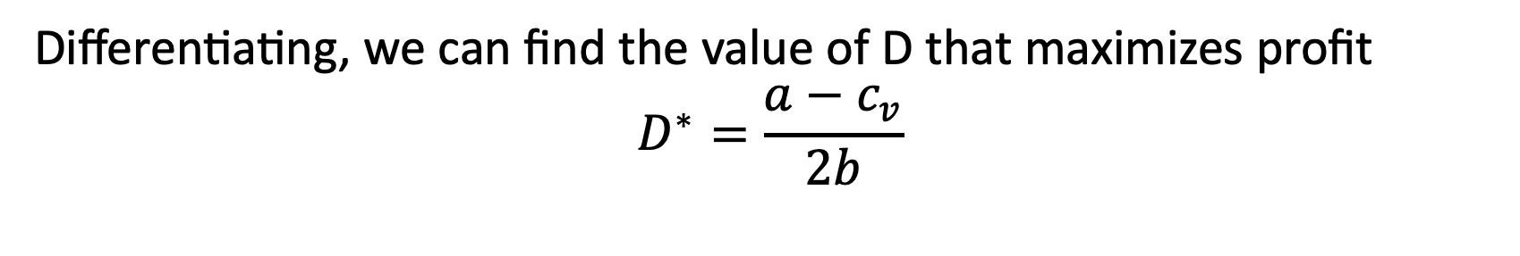

We can also find maximum profit…
Profit is revenue minus cost, so:
$$Profit=−bD^{2}+\left(a−c_{v}\right)D−C_{F}$$
$0≤D≤\frac{a}{b}$ and $a>0, b>0$
for
Differentiating, we can find the value of D that maximizes profit
$$D^{∗}=\frac{a−c_{v}}{2b}$$

Slide 21
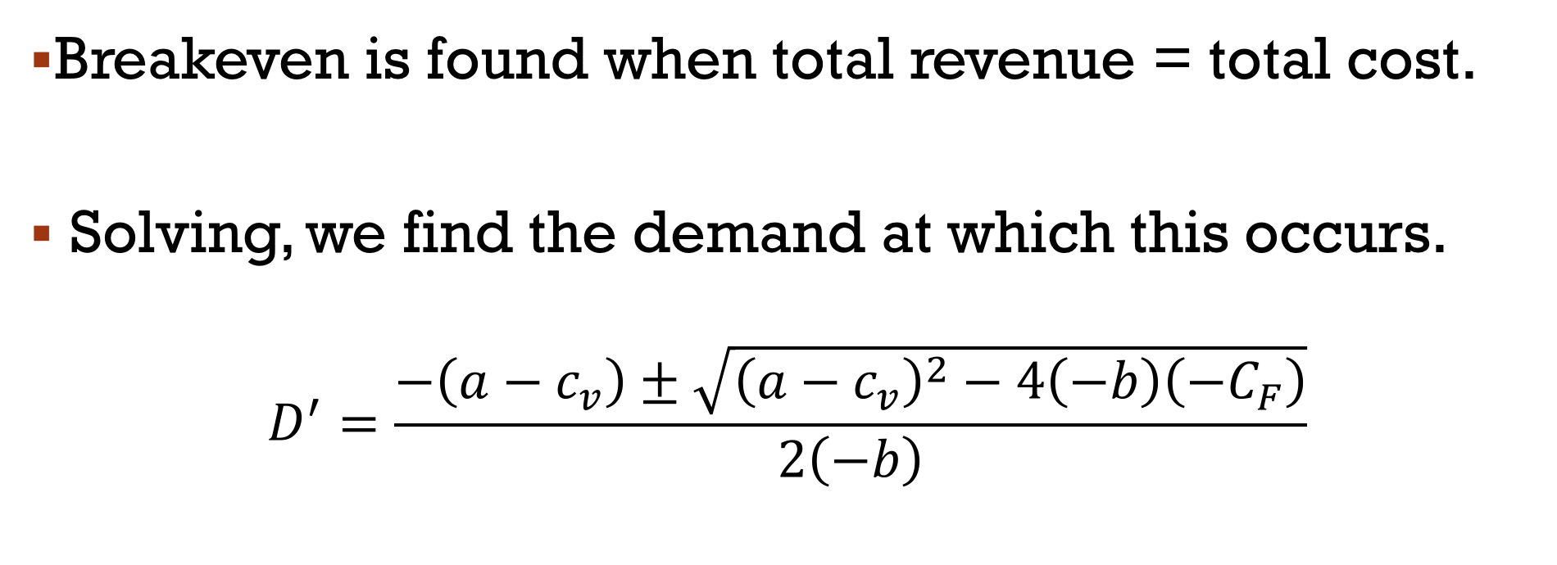
And we can find revenue/cost breakeven
Breakeven is found when total revenue = total cost.
Solving, we find the demand at which this occurs.
$$D^{′}=\frac{−\left(a−c_{v}\right)±\sqrt{{\left(a−c_{v}\right)}^{2}−4\left(−b\right)\left(−C_{F}\right)}}{2\left(−b\right)}$$

Slide 22
Engineers must consider cost in the design of products, processes and services
“Cost-driven design optimization” is critical in today’s competitive business environment.
In our brief examination we examine discrete and continuous problems that consider a single primary cost driver.
Notes:
Engineering Costs: Value of the economic resources used in the production of goods and services.
Examples: Land, labor, capital or initial investment, wages and
salaries, material purchases, utilities
Cost estimating: Approximating the cost of resources or activities
Cost estimating is necessary for any economic analysis
Key Question: Where do the numbers we use in an engineering economic analysis come from?
When working in industry, you may need to consult with
professional accountants to obtain such information

Slide 23
Two main tasks are involved in cost-driven design optimization
Determine the optimal value for a certain alternative’s design variable.
Select the best alternative, each with its own unique value for the design variable.
Cost models are developed around the design variable, X.

Slide 24
Optimizing a design with respect to cost is a four-step process
Identify the design variable that is the primary cost driver.
Express the cost model in terms of the design variable.
For continuous cost functions, differentiate to find the optimal value. For discrete functions, calculate cost over a range of values of the design variable.
Solve the equation in step 3 for a continuous function. For discrete, the optimum value has the minimum cost value found in step 3.

Slide 25
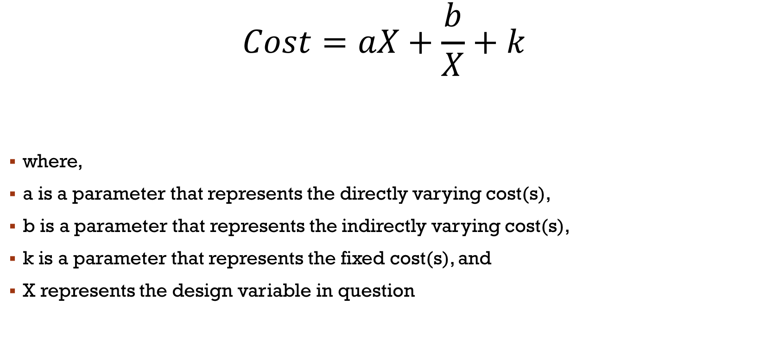
simplified cost function
$$Cost=aX+\frac{b}{X}+k$$
where,
a is a parameter that represents the directly varying cost(s),
b is a parameter that represents the indirectly varying cost(s),
k is a parameter that represents the fixed cost(s), and
X represents the design variable in question

Slide 26
“Present economy studies” can ignore the time value of money
Alternatives are being compared over one year or less.
When revenues and other economic benefits vary among alternatives, choose the alternative that maximizes overall profitability of defect-free output.
When revenues and other economic benefits are not present or are constant among alternatives, choose the alternative that minimizes total cost per defect-free unit.

Slide 27
Thank you ☺

